Slide 1
Smart Event
How to organize an event?

Slide 2
what is the idea ?
If there are an organization or technical team ,or any event organizer and need to set periorities for every step would be done to oraganize an event .
Our system will produce a service to handle ,organize and present all of these steps and will provide a communcation between every volunteer in the organizing team.
The system will service an outside support services with payment,more clearly the system will make a connection between the service provider(Photographers,Hall owners,graphic desiners,social media providers) and the service User ( Event organizer ,Team organizer,....etc).

Slide 3
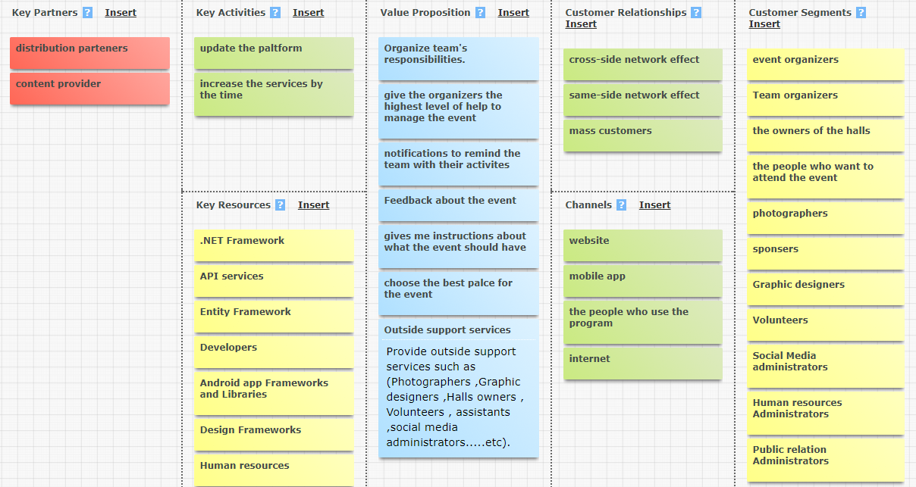
Business canvas model

Slide 4
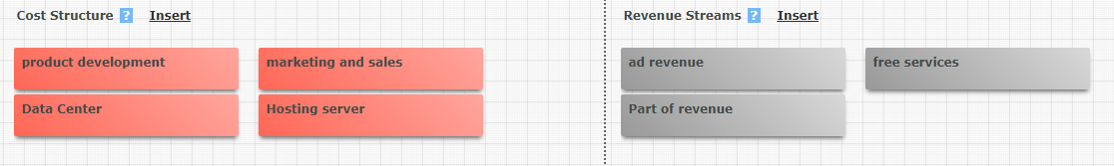
Smat Event

Slide 5
Requirements
1
Event Organizers or (Team Organizers)
1-Register as an organizer
2-create an event or join the event by the url or the name
3- if he creates an event ,he have to Input the needed information about the event
4-Contact with the other volunteers.
5-the system will produce an interface for determining all volunteers and thier fields
6-the system will determine the other needed fields and will put a plan for all of tasks for every volunteer.
7-the system will make a notifications for every member about thier missions.
8-it will be there an outside support services with payment for completing certain missions
Smat Event

Slide 6
Requirements
2
Event Organizers or (Team Organizers)
1-

